Slide 1
Final Year Project Presentation
Team XTreme
Text Extraction and Recognition from Natural Scene Images using Tesseract / EasyOCR
Team Members
Avichal Srivastava (17103004)
Vikas Kumar (17103026)
Himanshu Sharma (17103001)
Supervised & Guided By
Neeta Mam

Slide 2
REQUIREMENTS
Python 3 - We have used python as it contains many libraries that makes the task faster and easier. Also, the python is much more expressive and understandable than other languages.
OpenCV 3.4 - Used for image processing. EAST is based on OpenCV. Also, the image is being smoothened using the inbuilt libraries of OpenCV.
Tensorflow 1.5 - TensorFlow is an open source software library for high performance numerical computation. Its flexible architecture allows easy deployment of computation across a variety of platforms (CPUs, GPUs, TPUs), and from desktops to clusters of servers to mobile and edge devices.
Pytesseract – The library which has been developed to efficiently convert text in images into computer format using a well trained model provided the image passed is free from distortion and noises, etc.
Matplotlib - The library is used for showing rectangle boxes around identified text regions.
EasyOCR - The library is used for Text Detection and Text recognition based on Deep Learning Models.
A Good CPU for a faster image processing

Slide 3
INSTALLING THE
PACKAGES
pip install pytesseract
pip install PIL {Python Imaging Library}
pip install numpy==1.17.4
pip install opencv-python==3.4.0.14
pip install tensorflow-gpu==1.5.0
pip install easyocr==1.3.1
pip install matplotlib
from easyocr import Reader
import argparse

Slide 4


Tools
EAST Text Detector
“frozen_east_text_detection.pb” is the trained model file containing graph definitions and weights of the model based on Tensorflow. This is the model that will classify at which all places text is present in the image.
“images” folder contains the set of testing images.
“opencv_text_detection_image.py” is our main driving program which takes the image and the model file as an input and displays the image with highlighted text as a result.
Invocation: “python opencv_text_detection_image.py --image images/filename.jpg --east frozen_east_text_detection.pb”

Slide 5
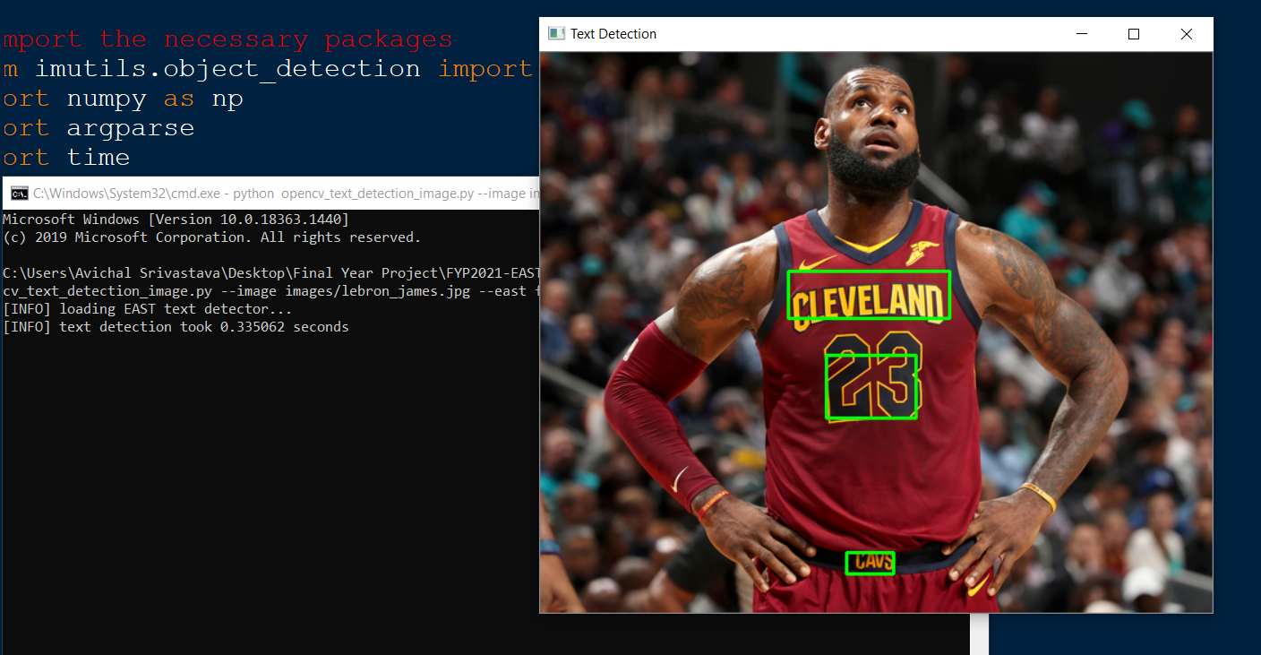
Working (EAST)

Slide 6
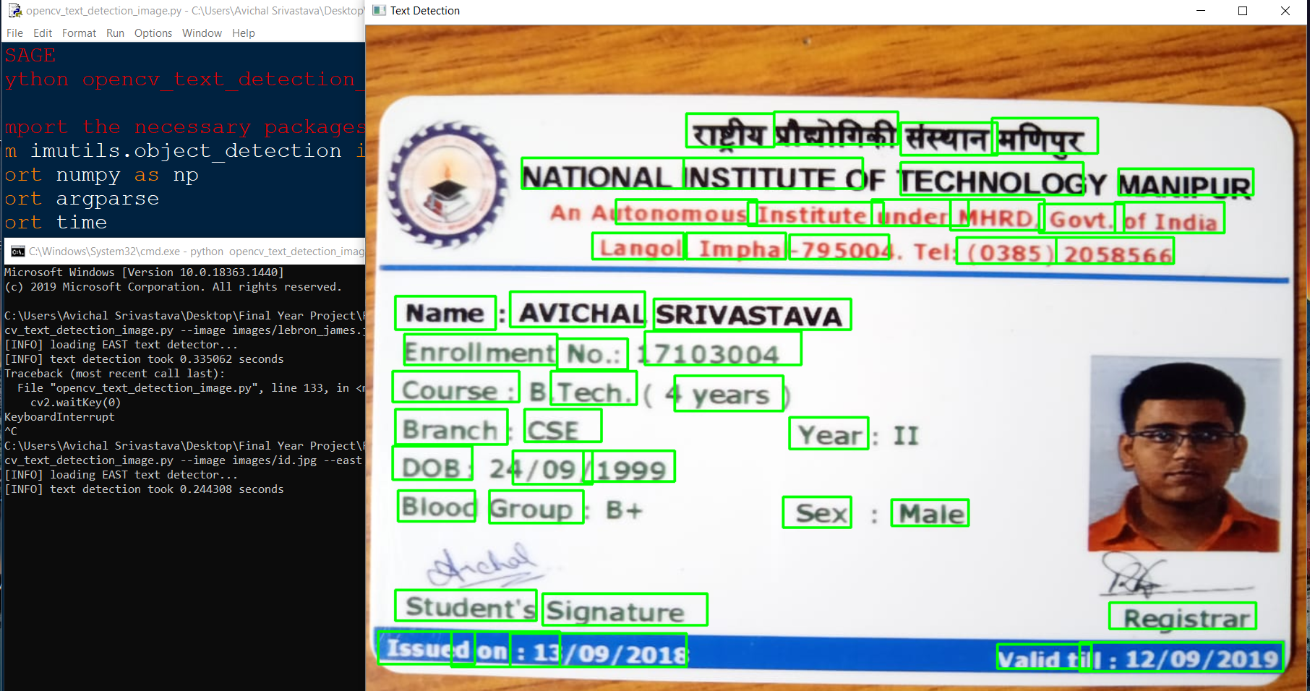
Working (EAST)

Slide 7
Tools
Tesseract Text Recognizer
“tesseract_prog.py” is our main driving program which takes the image file as an input and smoothens it and then sends to pytesseract function to convert to text.
“image_to_string” function of pytesseract is being used in the program to identify the text.
Three image smoothening functions using OpenCV functions are used to increase the quality of detection. This is often termed as image pre-processing.
Three techniques used: Grayscaling, Blurring, Image thresholding.
Invocation: “python tesseract_prog.py”

Slide 8
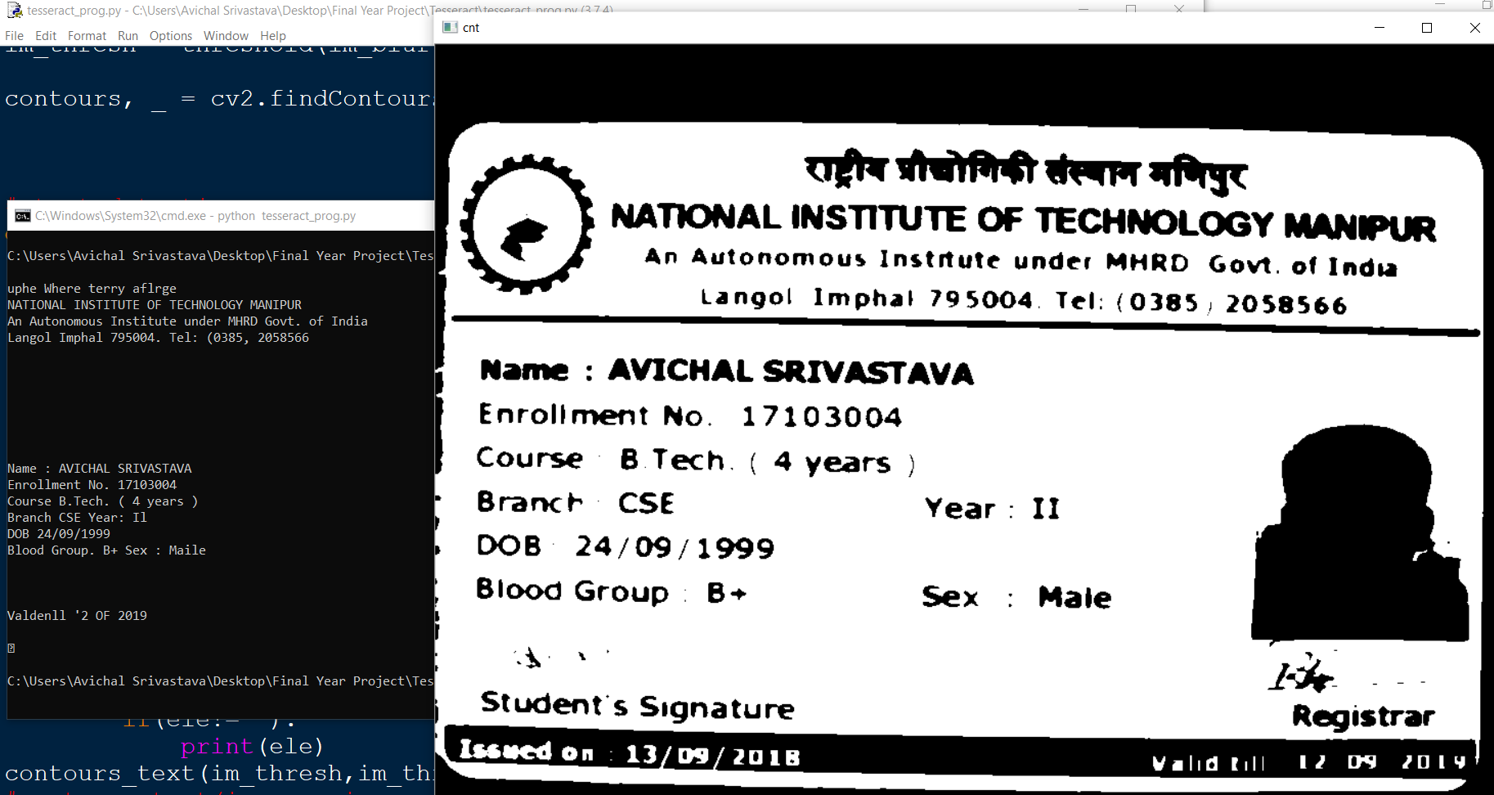
Working (Tesseract)

Slide 9
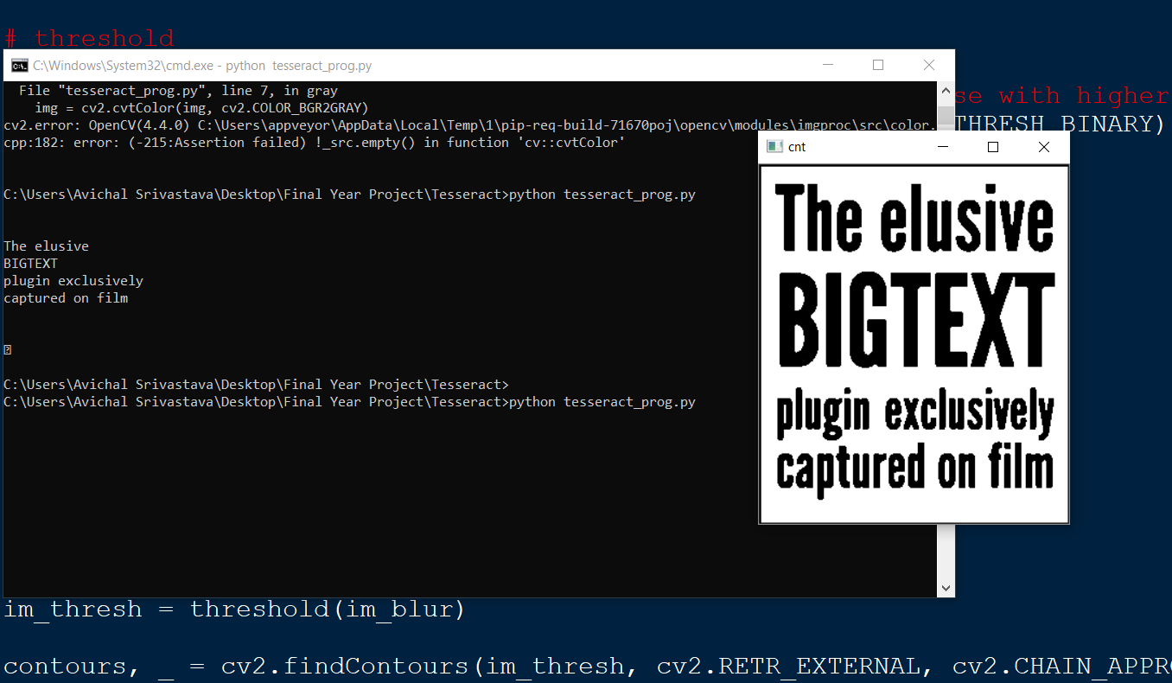
Working (Tesseract)

Slide 10
TESSERACT RESULTS
Tool | Test Images | Class | Total Words | Words correctly Identified | Accuracy Achieved
Tesseract (Before Image Processing) | ~100 | English | ~300 | ~220 | 73.33%
 | ~10 | Hindi | ~50 | ~33 | 66%
 | ~110 | English + Hindi | ~350 | ~253 | 72.2857 %
Tesseract (After Image Processing) | ~100 | English | ~300 | ~245 | 81.66%
 | ~10 | Hindi | ~50 | ~37 | 74%
 | ~110 | English + Hindi | ~350 | ~282 | 80.5714 %

Slide 11
EasyOCR:
EasyOCR :- Optical Character Recognition
EasyOCR is a Python package that allows computer vision developers to effortlessly perform Optical Character Recognition
It is an optical recognition library designed to read short texts such as serial numbers, expiry dates or lot codes printed on labels or on parts.
It uses an innovative segmentation method to detect blobs in the image, and then places textboxes over the detected blobs .
A character type (letter / digit / symbol / word) can be specified for each character in the text, improving recognition rate and speed.
Any Person Who Needs To Convert Documents Will Be Helped By EasyOCR Software.
EasyOCR Library supports 80+ languages.

Slide 12
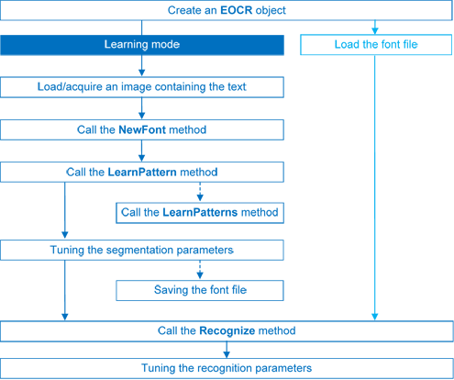
Internal WorkFlow
.

Slide 13
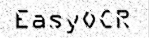
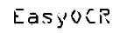
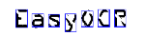
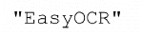
Recognizing Step
There are 4 steps to recognizing characters:
1. Raw image
2. Object segmentation
(Segmenting image characters based on pixels)
3. Character isolation
4. Character recognition

Slide 14
Image Processing
Grayscaling Smoothing: A grayscale (or graylevel) image is simply an image in which the only colors are shades of gray. The reason for differentiating such images from any other sort of color image is that less information needs to be provided for each pixel.
Blurring Smoothing: Blurring of an image removes “outlier” pixels that may be noise in the image. Blurring is an example of applying a low-pass filter to an image. In computer vision, the term “lowpass filter” applies to removing noise from an image while leaving the majority of the image intact.
Image Threshold Smoothing: Image thresholding is a simple form of image segmentation. It is a way to create a binaryimage from a grayscale or full color image. This is typically done in order to separate "object" or foreground pixels from background pixels to help in image processing.
Python Function to increase Image Resolution:
Python provides a method to extensively save images with desired image quality.

Slide 15
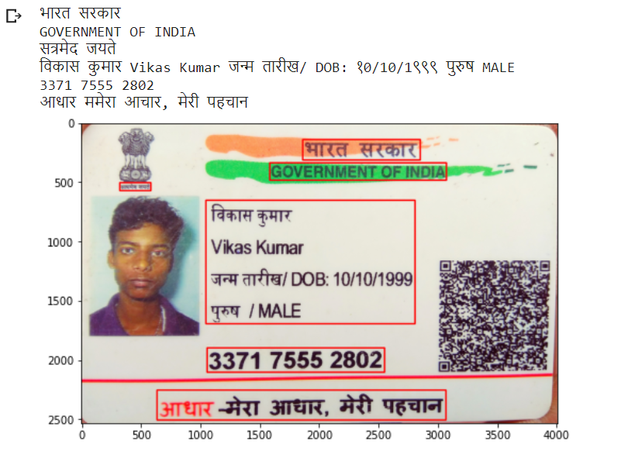
Working (EasyOCR)
Hindi-English Text Recognition Using EasyOCR

Slide 16
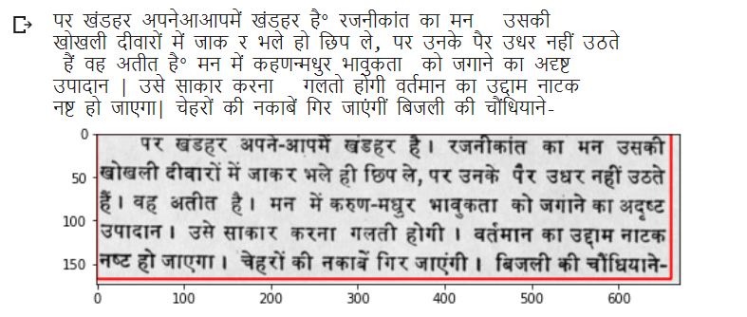
Working (EasyOCR)
Hindi Text Recognition Using EasyOCR

Slide 17
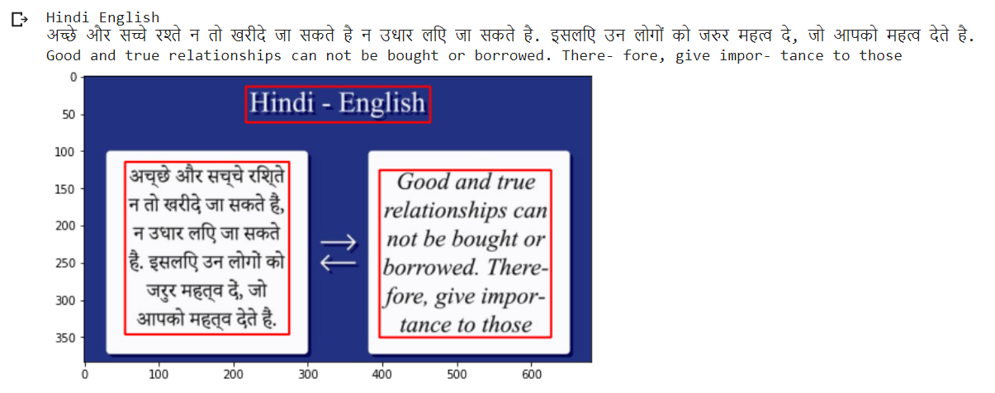
Working (EasyOCR)
Hindi-English Text Recognition Using EasyOCR

Slide 18
Project Live Demonstration

Slide 19
EasyOCR RESULTS
Tool | Test Images | Class | Total Words | Words correctly Identified | Accuracy Achieved
EasyOCR (Before Image Processing) | ~500 | English | ~1500 | ~1286 | 85.7333%
 | ~50 | Hindi | ~200 | ~169 | 84.5%
 | ~550 | English + Hindi | ~1700 | ~1455 | 85.5882 %
EasyOCR (After Image Processing) | ~500 | English | ~1500 | ~1385 | 92.3333%
 | ~50 | Hindi | ~200 | ~183 | 91.5%
 | ~550 | English + Hindi | ~1700 | ~1568 | 92.2353 %

Slide 20
Advantages Of EasyOCR
EasyOCR supports the GPU version and the performance on the GPU is much better than Tesseract.
With noisy images, EasyOCR works better.
EasyOCR offers more confidence of the extracted text that can be in use for further analysis.
Disadvantages Of EasyOCR
If the image contains languages outside those given in the arguments of the language, also the outcomes may be poor.
On handwritten text, it would give low results.
Poor quality scans may generate poor OCR quality in general.

Slide 21
Applications (OCR)
Data Entry for Business Documents, ex. cheque, passport, invoice , etc.
Automatic car number plate recognition.
Traffic sign boards Recognition.
Make electronic images of documents searchable, ex. Google Books.
Converting handwriting in real-time to control a computer, also known as Pen Computing.
Assistive technology for blind and visually impaired users.
Digital Libraries (Reading information from scanned pages)
Inter – Language Translations
And many more....

Slide 22
Conclusion
EasyOCR is the simplest way of applying optical character recognition and its the most accurate by far. For most tested images and extended over a wide range of languages, it is easy to use and has amazing accuracy.
Based on the project results:
Tesseract is also an efficient tool for text recognition, but our testing proves that its accuracy drops by significant amount when used for other languages other than English.
EAST is a very effective tool for Text Detection and works much better than other text detectors such as YOLO ,etc.
The final model accuracy achieved for Hindi and English Languages after detailed image pre-processing is concluded to be 92.2353% using EasyOCR.

Slide 23
THANK YOU

